Slide 1
DEVICE MANAGEMENT

Slide 2
Device Manager is a component of the Microsoft Windows operating system. It allows users to view and control the hardware attached to the computer. When a piece of hardware is not working, the offending hardware is highlighted for the user to deal with. The list of hardware can be sorted by various criteria.

Slide 3
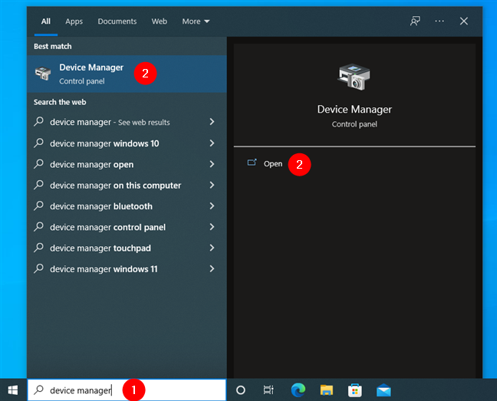
What is the purpose of Windows Device Manager?
Device Manager displays a graphical view of the hardware that is installed on your computer. Use this tool when you want to view and manage hardware devices and their drivers.
What happens if I disable a device in Device Manager?
Windows enables all devices it recognizes. Once disabled, Windows will no longer assign system resources to the device and no software on your computer will be able to use it.
How to open the Device Manager using search
One of the fastest ways to run Device Manager in Windows 10 is by using the search box near the Start button. In it, type “device” or “device manager” and click or tap on the appropriate search result.

Slide 4
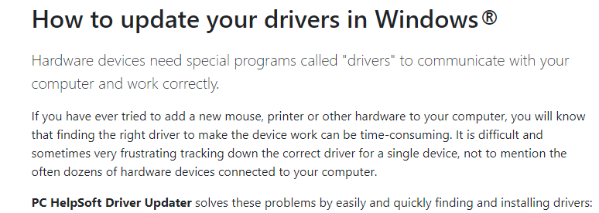

Slide 5
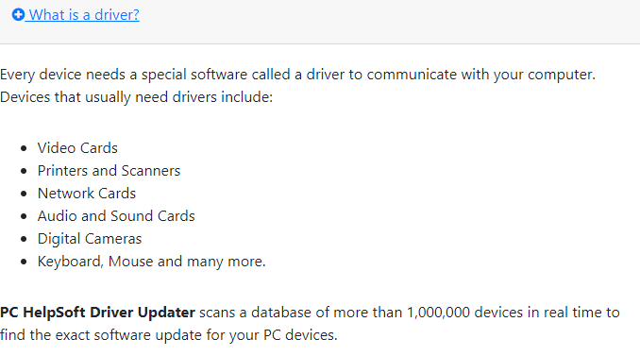

Slide 6
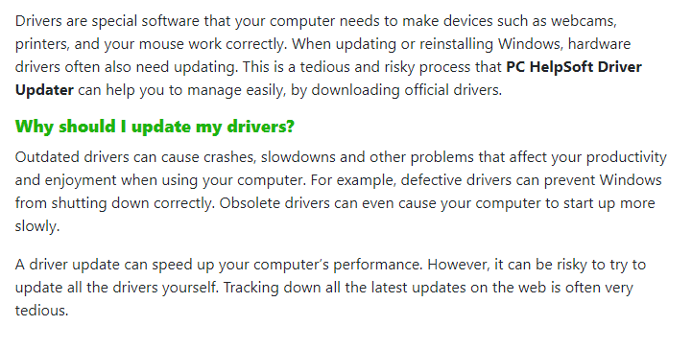

Slide 7
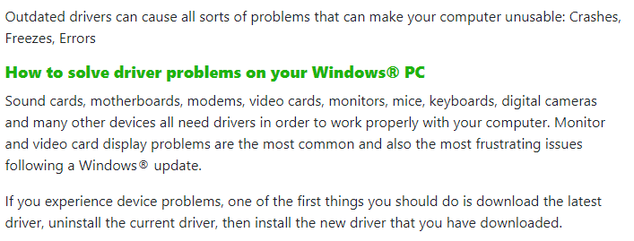

Slide 8

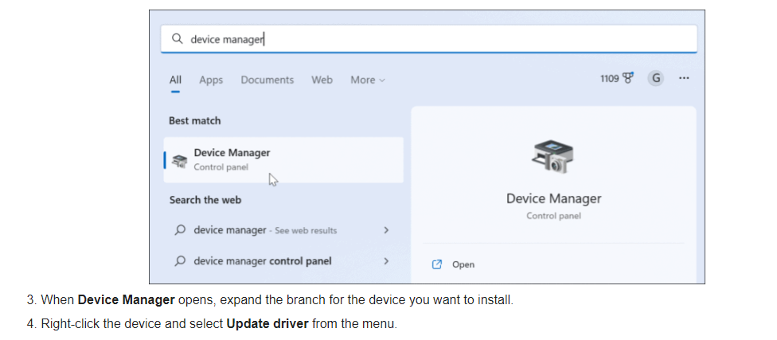

Slide 9
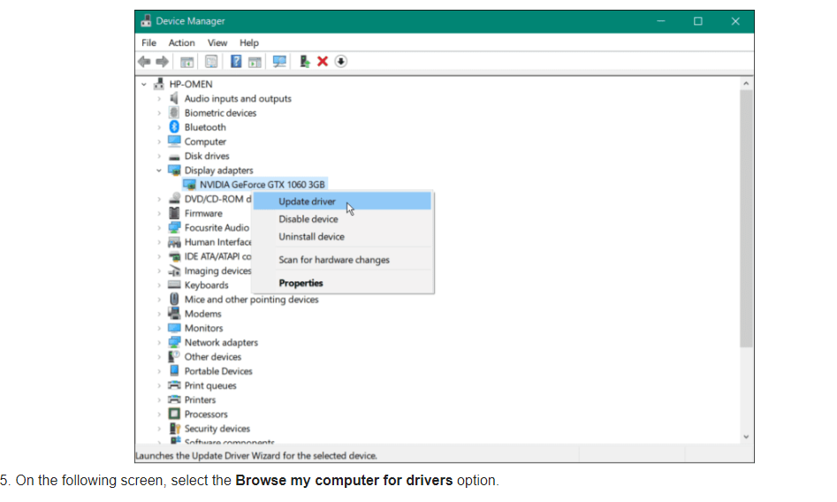

Slide 10
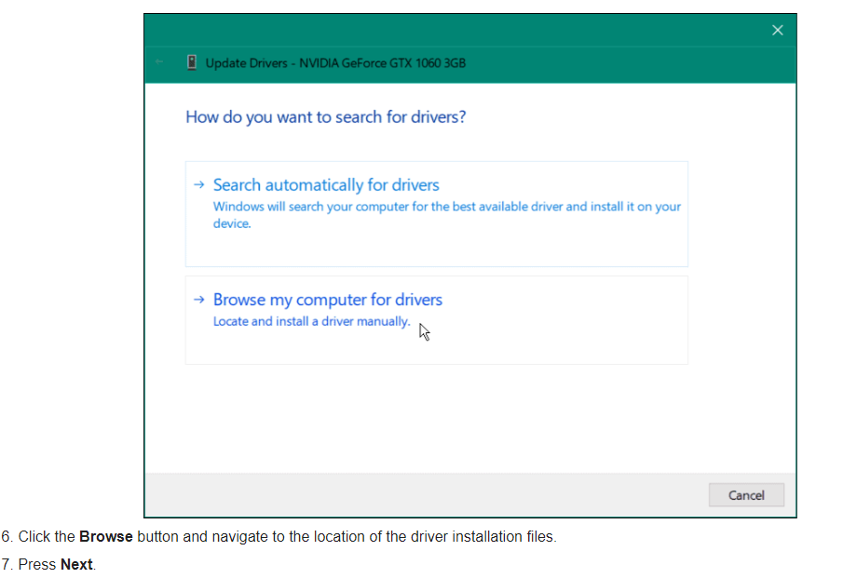

Slide 11
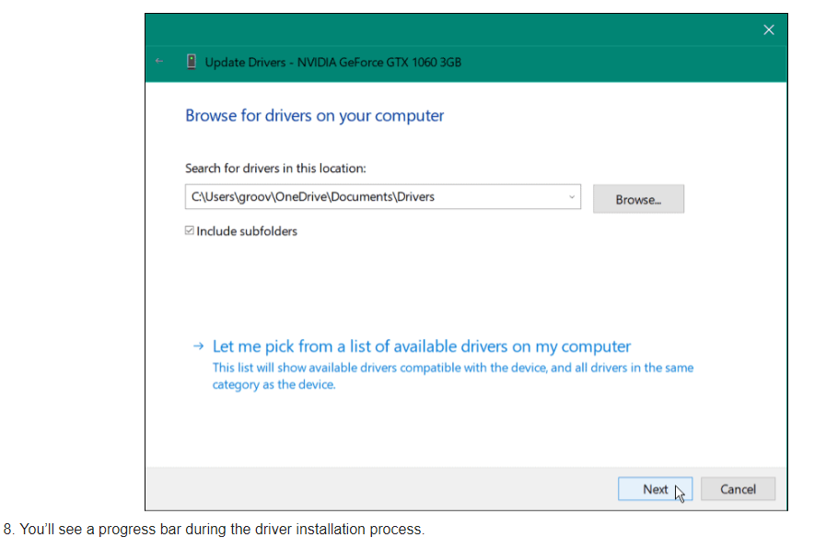

Slide 12
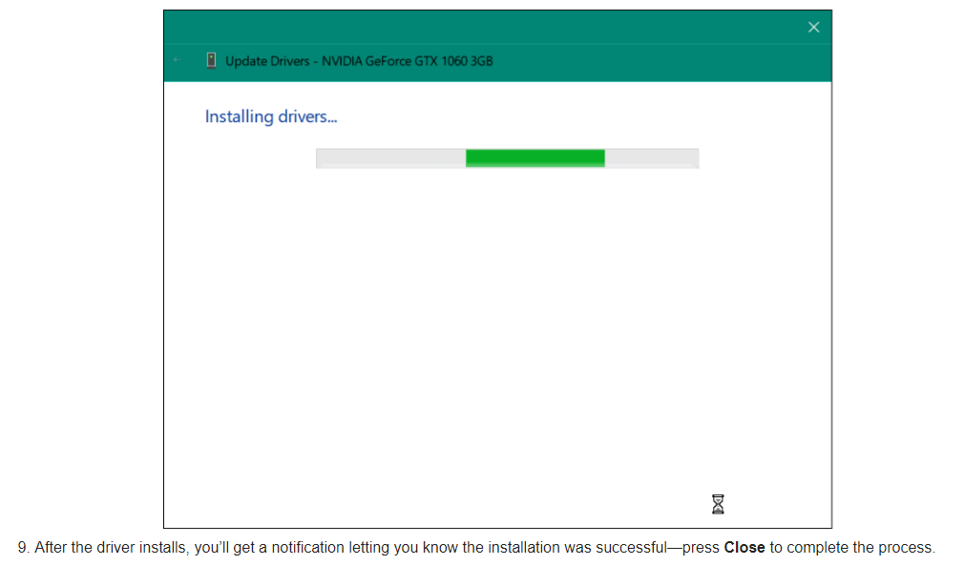

Slide 13
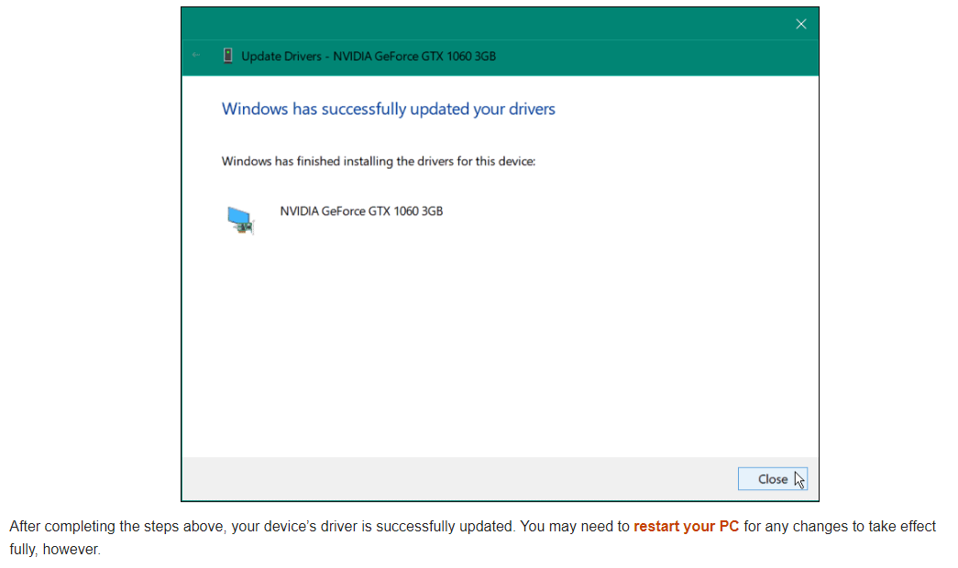

Slide 14
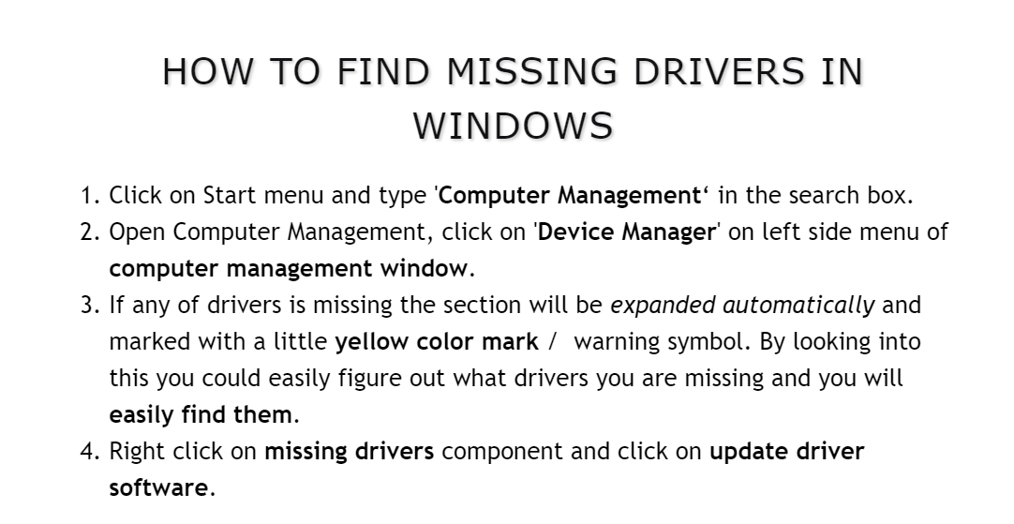

Slide 15
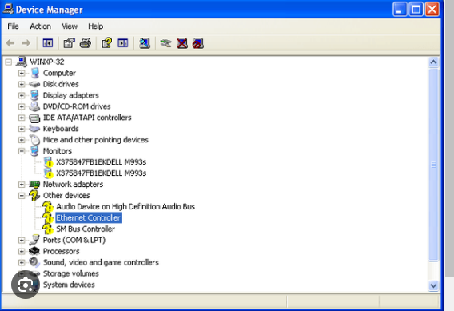

Slide 16
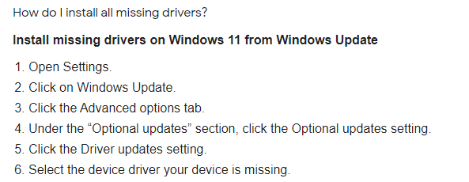

Slide 17
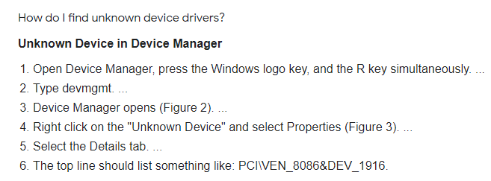

Slide 18
Why can't I open Device Manager?
Sometimes corrupted system files could be responsible for Device Manager not working/opening/responding. To solve your issue, you can try to perform an SFC scan. System File Checker (SFC) is the inbuilt utility that can help scan your device for detecting corrupted or missing system files and repair them.
Why would a device be hidden in Device Manager?
Devices that you install that are not connected to the computer (such as a Universal Serial Bus [USB] device or "ghosted" devices) are not displayed in Device Manager, even when you click Show hidden devices.

Slide 19
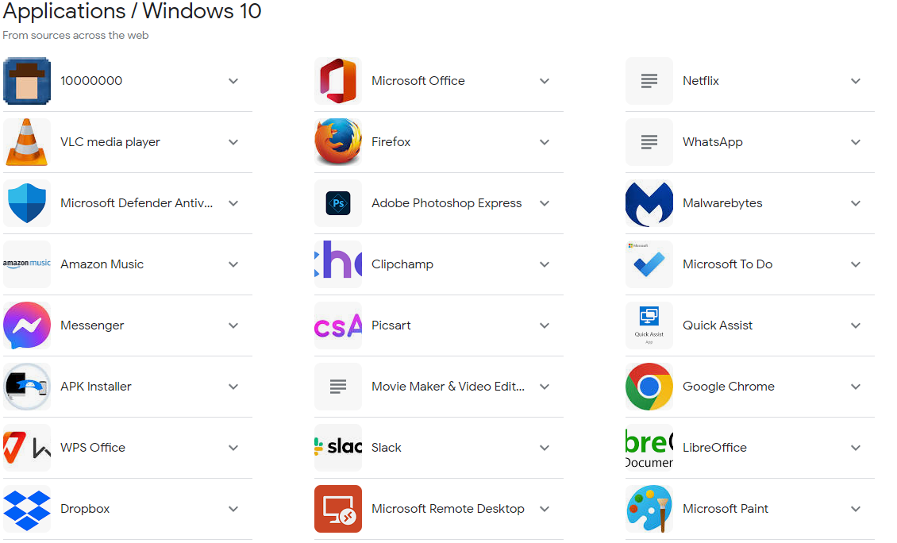
Application software in Windows 10 :

Slide 20
